Slide 1
Intelligent Agents
Chapter 2

Slide 2
Outline
Agents and environments
Rationality
PEAS (Performance measure, Environment, Actuators, Sensors)
Environment types
Agent types

Slide 3
Agents
An agent is anything that can be viewed as perceiving its environment through sensors and acting upon that environment through actuators
Human agent: eyes, ears, and other organs for sensors; hands, legs, mouth, and other body parts for actuators
Robotic agent: cameras and infrared range finders for sensors; various motors for actuators

Slide 4
Percept & Percept Sequence
percept: refer to the agent’s perceptual inputs at any given instant.
An agent’s percept sequence is the complete history of everything the agent has ever perceived
an agent’s choice of action at any given instant can depend on the entire percept sequence observed to date, but not on anything it hasn’t perceived

Slide 5

Agents and environments
An agent’s behavior is described by the agent function that maps any given percept sequence to an action.
[f: P* → A]
agent = architecture + program
The agent program runs on the physical architecture to produce f

Slide 6
keep these two ideas distinct.
agent function : is an abstract mathematical description;
agent program: ; is a concrete implementation, running within some physical system.
The table is, of course, an external characterization of the agent

Slide 7

Vacuum-cleaner world
One very simple agent function is the following: if the current square is dirty, then suck; otherwise, move to the other square.

Slide 8
A vacuum-cleaner agent
Percepts: location and contents, e.g., [A,Dirty]
Actions: Left, Right, Suck, NoOp
\input{tables/vacuum-agent-function-table}

Slide 9
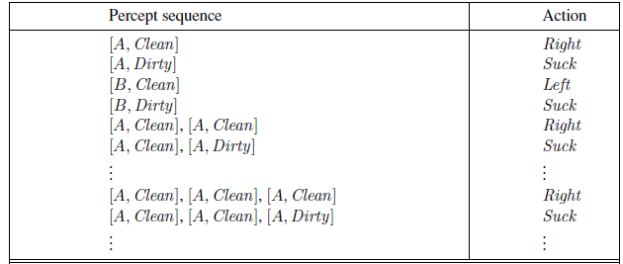
Partial tabulation
What is the right way to fill out the table?
what makes an agent good or bad, intelligent or stupid?
Conclusion: agent is meant to be a tool for analyzing systems

Slide 10
Rational agents
An agent should strive to "do the right thing", based on what it can perceive and the actions it can perform. The right action is the one that will cause the agent to be most successful
This sequence of actions causes the environment to go through a sequence of states.
If the sequence is desirable, then the agent
has performed well.
This notion of desirability is captured by a performance measure that evaluates any given sequence of environment states.

Slide 11
Performance measure
Performance measure: An objective criterion for success of an agent's behavior
E.g., performance measure of a vacuum-cleaner agent could be amount of dirt cleaned up, amount of time taken, amount of electricity consumed, amount of noise generated, etc.

Slide 12
Rational Agent
With a rational agent, what you ask for is what you get.
it is better to design performance measures according to what one actually
wants in the environment, rather than according to how one thinks the agent should behave.

Slide 13
Rational agents
Rational Agent: For each possible percept sequence, a rational agent should select an action that is expected to maximize its performance measure, given the evidence provided by the percept sequence and whatever built-in knowledge the agent has.

Slide 14
Rational agents
Rationality is distinct from omniscience (all-knowing with infinite knowledge)
An omniscient agent knows the actual outcome of its actions and can act accordingly.
but omniscience is impossible in reality.
Ex: Road Crossing.
rationality is not the same as perfection.
Rationality maximizes expected performance
while perfection maximizes actual performance.

Slide 15
Rational agents
Agents can perform actions in order to modify future percepts so as to obtain useful information (information gathering, exploration) eg: looking into the road before crossing
Exploration for information gathering.
An agent is autonomous if its behavior is determined by its own experience (with ability to learn and adapt

Slide 16
PEAS
PEAS: Performance measure, Environment, Actuators, Sensors
Must first specify the setting for intelligent agent design
Consider, e.g., the task of designing an automated taxi driver:
  Performance measure
  Environment
  Actuators
  Sensors

Slide 17
PEAS
Must first specify the setting for intelligent agent design
Consider, e.g., the task of designing an automated taxi driver:
  Performance measure: Safe, fast, legal, comfortable trip, maximize profits
  Environment: Roads, other traffic, pedestrians, customers
  Actuators: Steering wheel, accelerator, brake, signal, horn
  Sensors: Cameras, sonar, speedometer, GPS, odometer, engine sensors, keyboard

Slide 18
PEAS
Agent: Medical diagnosis system
Performance measure: Healthy patient, minimize costs, lawsuits
Environment: Patient, hospital, staff
Actuators: Screen display (questions, tests, diagnoses, treatments, referrals)
Sensors: Keyboard (entry of symptoms, findings, patient's answers)

Slide 19
PEAS
Agent: Part-picking robot
Performance measure: Percentage of parts in correct bins
Environment: Conveyor belt with parts, bins
Actuators: Jointed arm and hand
Sensors: Camera, joint angle sensors

Slide 20
PEAS
Agent: Interactive English tutor
Performance measure: Maximize student's score on test
Environment: Set of students
Actuators: Screen display (exercises, suggestions, corrections)
Sensors: Keyboard

Slide 21
Task Environment types
Fully observable (vs. partially observable): An agent's sensors give it access to the complete state of the environment at each point in time.
A task environment is effectively fully observable if the sensors detect all aspects that are relevant to the choice of action; relevance, in turn, depends on the performance measure.
the agent need not maintain any internal state to keep track of the world

Slide 22
Task Environment types
An environment might be partially observable because of noisy and inaccurate sensors or because parts of the state are simply missing from the sensor data
for example, a vacuum agent with only a local dirt sensor
cannot tell whether there is dirt in other squares,
and an automated taxi cannot see what other drivers are thinking.

Slide 23
Task Environment types
Single agent (vs. multiagent): An agent operating by itself in an environment.
crossword puzzle - Single agent
Chess – Competitive multiagent environment
Taxi Driver - cooperative multiagent – to avoid collisions
partially competitive – to occupy parking space

Slide 24
Task Environment types
Multiagent to behave rational
Communication
in some competitive environments, randomized behavior is rational because it avoids the pitfalls of predictability.

Slide 25
Task Environment types
Deterministic (vs. stochastic): The next state of the environment is completely determined by the current state and the action executed by the agent.
Adv: an agent need not worry about uncertainty in a fully observable, deterministic environment.
Eg: The vacuum world, Taxi driving

Slide 26
Task Environment types
a nondeterministic environment is one in which actions are characterized by their possible outcomes, but no probabilities are attached to them.
Nondeterministic environment descriptions are usually associated with performance measures that require the agent to succeed for all possible outcomes of its actions.

Slide 27
Task Environment types
Episodic (vs. sequential): The agent's experience is divided into atomic "episodes" (each episode consists of the agent perceiving and then performing a single action), and the choice of action in each episode depends only on the episode itself.
Eg: Many classification tasks are episodic.
an agent that has to spot defective parts on an assembly line

Slide 28
Task Environment types
In sequential environments the current decision could affect all future decisions.
Eg: Chess and taxi driving
in both cases, short-term actions can have long-term consequences.

Slide 29
Environment types
Static (vs. dynamic): The environment is unchanged while an agent is deliberating. (The environment is semidynamic if the environment itself does not change with the passage of time but the agent's performance score does)
Crossword puzzles, Chess, when played with a clock, Taxi driving

Slide 30
Environment types
Discrete (vs. continuous): A limited number of distinct, clearly defined percepts and actions.
The discrete/continuous distinction applies to the state of the environment, to the way time is handled, and to the percepts and actions of the agent.
Eg: chess Environment, Taxi Driving.

Slide 31
Environment types
Known vs. unknown
In a known environment, the outcomes (or outcome probabilities if the environment is stochastic) for all actions are given.
Eg: solitaire card games, new video game,

Slide 32
Environment types
Chess with Chess without Taxi driving
a clock a clock
Fully observable Yes Yes No
Deterministic Strategic Strategic No
Episodic No No No
Static Semi Yes No
Discrete Yes Yes No
Single agent No No No
The environment type largely determines the agent design
The real world is (of course) partially observable, stochastic, sequential, dynamic, continuous, multi-agent

Slide 33
Agent functions and programs
An agent is completely specified by the agent function mapping percept sequences to actions
One agent function (or a small equivalence class) is rational
Aim: find a way to implement the rational agent function concisely

Slide 34
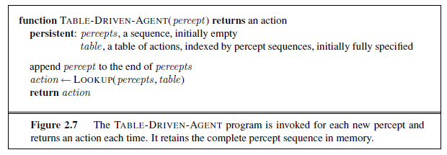
Table-Driven-Agent
Drawbacks:
  Huge table
  Take a long time to build the table
  No autonomy
  Even with learning, need a long time to learn the table entries

Slide 35
Agent types
Four basic types in order of increasing generality:
Simple reflex agents
Model-based reflex agents
Goal-based agents
Utility-based agents

Slide 36

Simple reflex agents

Slide 37
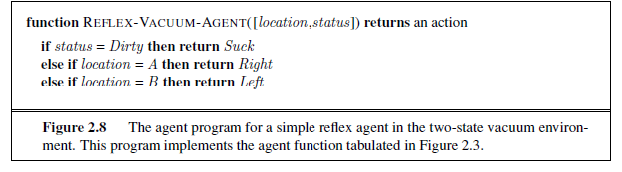
Simple reflex agents

Slide 38

Model-based reflex agents

Slide 39

Goal-based agents

Slide 40

Utility-based agents

Slide 41

Learning agents

